Slide 1
NLP Topic Modeling of CNN Web Articles via LDA for ESL APPLICATIONS
Barrett Nibling
bnibling@gmail.com

Slide 2

CURRENT AFFAIRS IN THE ESL CLASSROOM
Relevant and Topical
Living Language
More than Vocab and Grammar
Relies on News Articles
1
Notes:
As a former English teacher in Japan, providing my students with relevant material that was both useful for their learning and classroom engagement was of utmost importance. I often found my most successful lessons were the ones where we discussed current affairs in the news, as these were topics they were already discussing among themselves in Japanese. More importantly, due to the nature of most of these lessons, they often allowed me to teach more than just vocabulary and grammar, by instilling my students with critical thinking skills and offering them an avenue to express their own ideas on worldly problems. That is why I used to offer two different level elective English courses that were focused solely on current affairs in the world and they relied heavily on news articles as source material for discussions.

Slide 3

INHERENT PROBLEMS
No Textbook
Steep Learning Curve
Hard to Build Balanced Curriculum
Choosing Topics
Cannot Predict the News
2
Notes:
A big inherent problem with this style of class, as hinted above, is that there is no readily available textbook to teach current news and the responsibility of building a proper curriculum rests solely on the teacher. The challenge in planning for such a class, short of predicting the news, is balancing student exposure to an assortment of topics that can properly expand their lexicon, while keeping in mind new topics take more time to digest and recurring topics have limited opportunities to learn new terms and ideas. Additionally, students have different interests from each other. Some enjoyed recent topics on scientific discoveries, some wanted to discuss world politics, while others, sadly the majority, wanted to discuss the latest scandals in the Korean pop world. As a teacher, it was important to recognize the potential learning experience each topic has to offer and which subjects offer the most in terms of an overall learning experience
But even with this in mind, it was hard to build a curriculum that could offer a diverse enough material throughout the year because it is impossible to predict the news. It seemed that each year we would finish discussing a particular topic, only to have the next big news story be something similar and feeling obligated to go over it, thus delaying or scrapping other lessons because of it. Some semesters last year felt more like a political science class than an English class and I could tell from the look in my students’ eyes that they were tired of it. And I know I was not alone when dealing with these issues as almost all of my old colleagues have expressed similar concerns in teaching current affairs classes as well. So, there must be a better way, right?

Slide 4
Questions
Can we utilize natural language processing (NLP) methodology on news articles, namely topic modeling, to ensure students get exposure to a range of relevant topics in current news?
Can these same NLP methods procure a vocabulary list of key terms for said topics that can expedite the steep learning curve of learning unfamiliar topics?
Ultimately, can we build an application using the results of our findings and model that to be put to use in the classroom?
3
Notes:
So, there must be a better way, right?
This is why, the question I propose for this project is:
**Can we utilize natural language processing (NLP) methodology on news articles, namely topic modeling, to ensure students get exposure to a range of relevant topics in current news?**
Namely, can we look at historic news article data, extract key recurring topics with NLP, and use these topics to better build balanced curricula for courses that depend on teaching students in current affairs? Furthermore, can these same NLP methods procure a vocabulary list of key terms for said topics that can expedite the steep learning curve of learning unfamiliar topics?

Slide 5
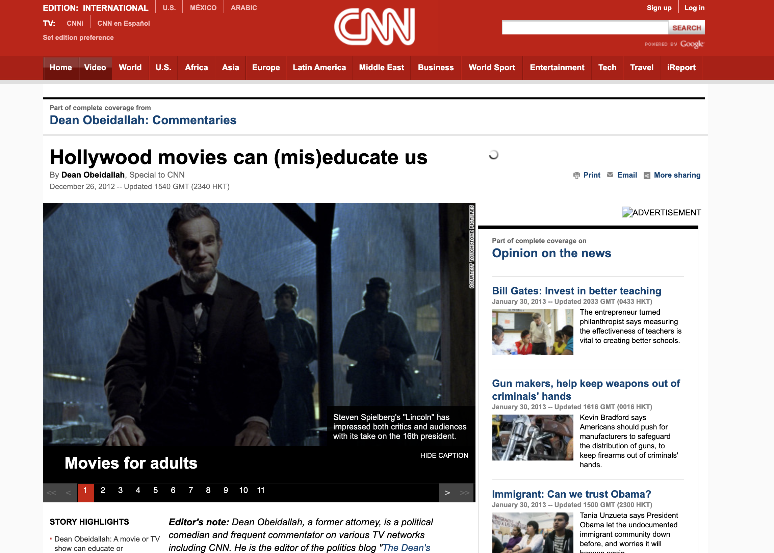
Data - CNN Web Articles
Collected by DeepMind
Conducted from April 2007 to April 2015
Over 90,000 CNN web articles scraped as:
HTML files
Text files containing main story and highlights
4
https://cs.nyu.edu/~kcho/DMQA/
Notes:
A big inherent problem with this style of class, as hinted above, is that there is no readily available textbook to teach current news and the responsibility of building a proper curriculum rests solely on the teacher. The challenge in planning for such a class, short of predicting the news, is balancing student exposure to an assortment of topics that can properly expand their lexicon, while keeping in mind new topics take more time to digest and recurring topics have limited opportunities to learn new terms and ideas. Additionally, students have different interests from each other. Some enjoyed recent topics on scientific discoveries, some wanted to discuss world politics, while others, sadly the majority, wanted to discuss the latest scandals in the Korean pop world. As a teacher, it was important to recognize the potential learning experience each topic has to offer and which subjects offer the most in terms of an overall learning experience
But even with this in mind, it was hard to build a curriculum that could offer a diverse enough material throughout the year because it is impossible to predict the news. It seemed that each year we would finish discussing a particular topic, only to have the next big news story be something similar and feeling obligated to go over it, thus delaying or scrapping other lessons because of it. Some semesters last year felt more like a political science class than an English class and I could tell from the look in my students’ eyes that they were tired of it. And I know I was not alone when dealing with these issues as almost all of my old colleagues have expressed similar concerns in teaching current affairs classes as well. So, there must be a better way, right?

Slide 6
Process and Methodology
Extraction of Text Data from Source
Read text in from files
Extract publishing dates
Text Preprocessing
EDA
Remove stop words, tokenize, punctuation, lemmatization, etc.
Summarize*
Vectorizing and Modeling
CountVectorizer() or Bag-of-Words (BoW)
LDA (Latent Dirichlet Allocation)
5
Notes:
Extraction of text data from source
Removal of stop words (common filler words), numbers, punctuation, non-English characters, and any other irregularities
Tokenize the words
Lemmatization/stemming of tokens based on part of speech tagging
Summarize token to further reduce dimensionality
Vectorize summaries into a sparse matrix that can be analyzed (CountVectorizer and/or TfidfVectorizer)

Slide 7
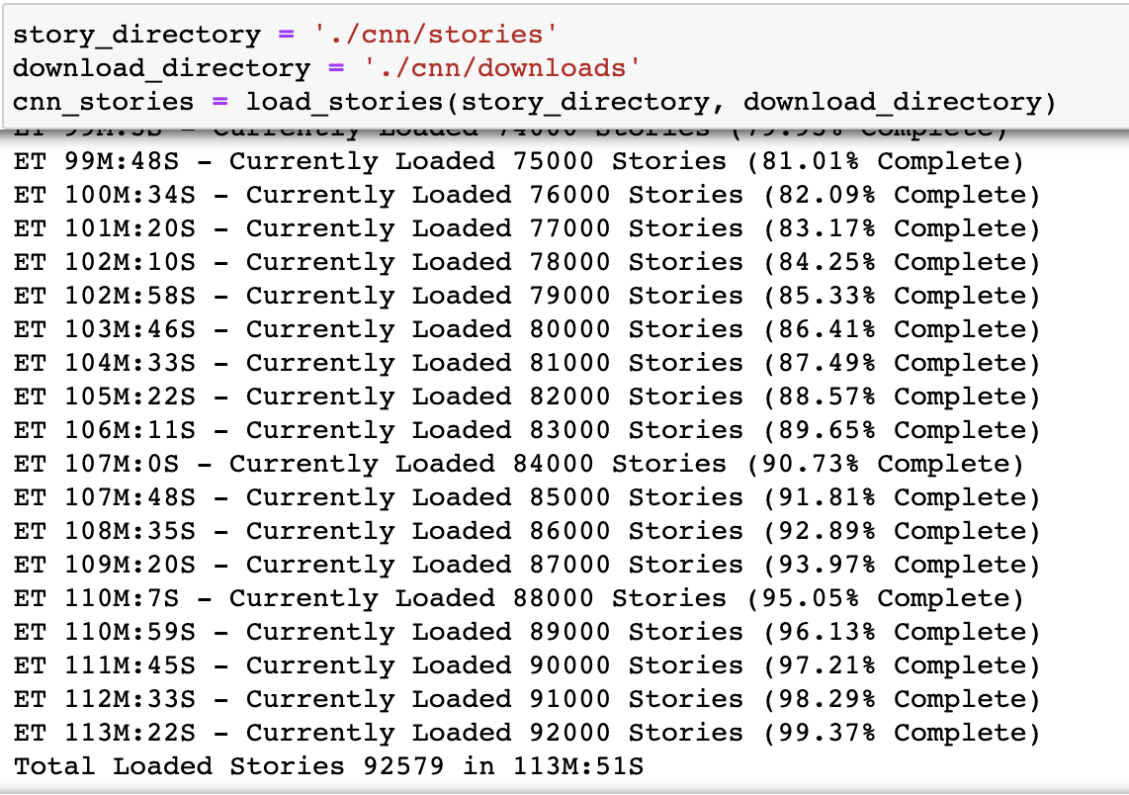
1. Data Extraction
Built multiple functions that:
Loaded text files
Split story and highlights
Scraped publishing date
Compiled into Pandas DataFrame
Exported using Pickle
Loaded a total of 92,579 stories in 113 minutes and 51 seconds
6

Slide 8
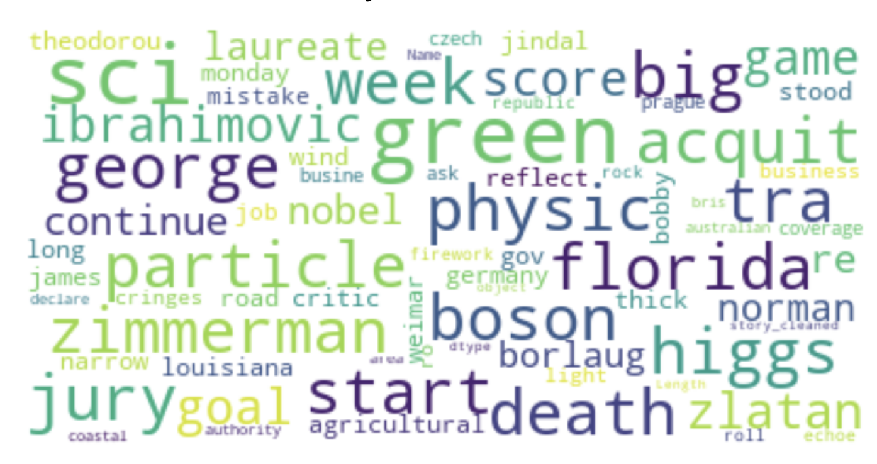
2. Preprocessing Text Data
In order to reduce dimensionality of the text:
Dropped stories that were less than 5 sentences in length
Removed common “stop words”
Removed numerical values
Removed punctuation
Removed non-English characters
Removed “CNN”
Tokenized in order to Lemmatize
Untokenized back into DataFrame
Summarized using gensim
(currently not utilized)
7

Slide 9
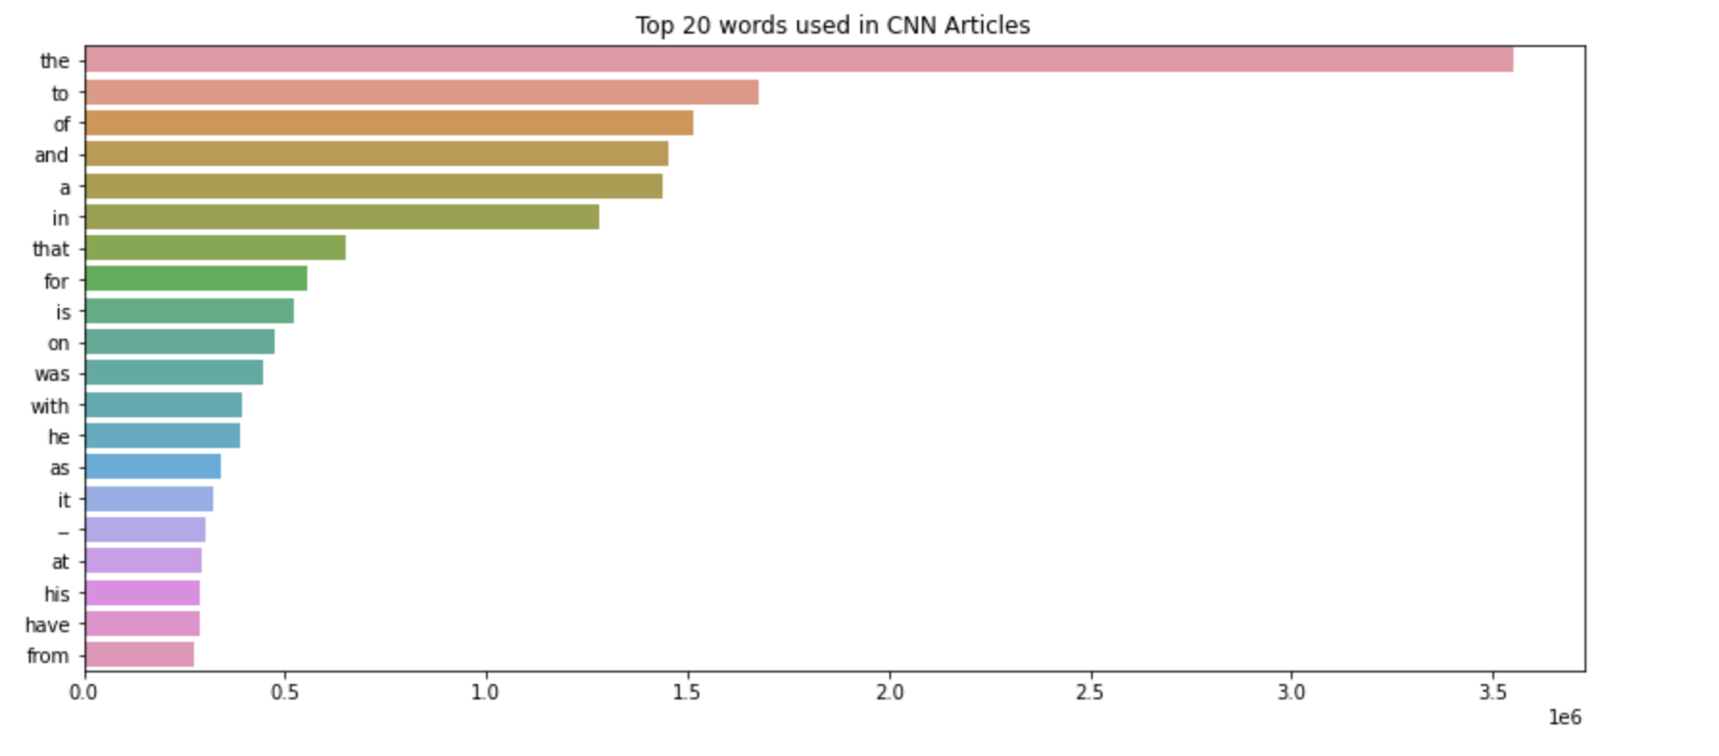
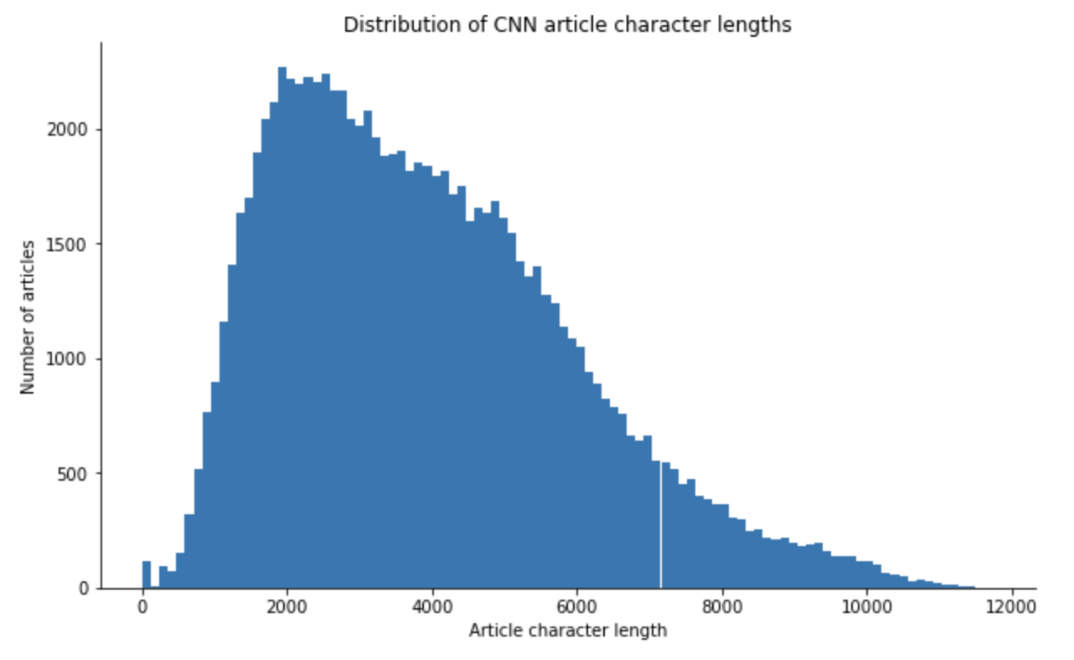
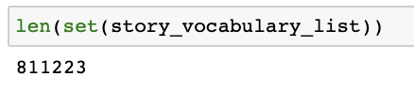
Before Preprocessing

Slide 10
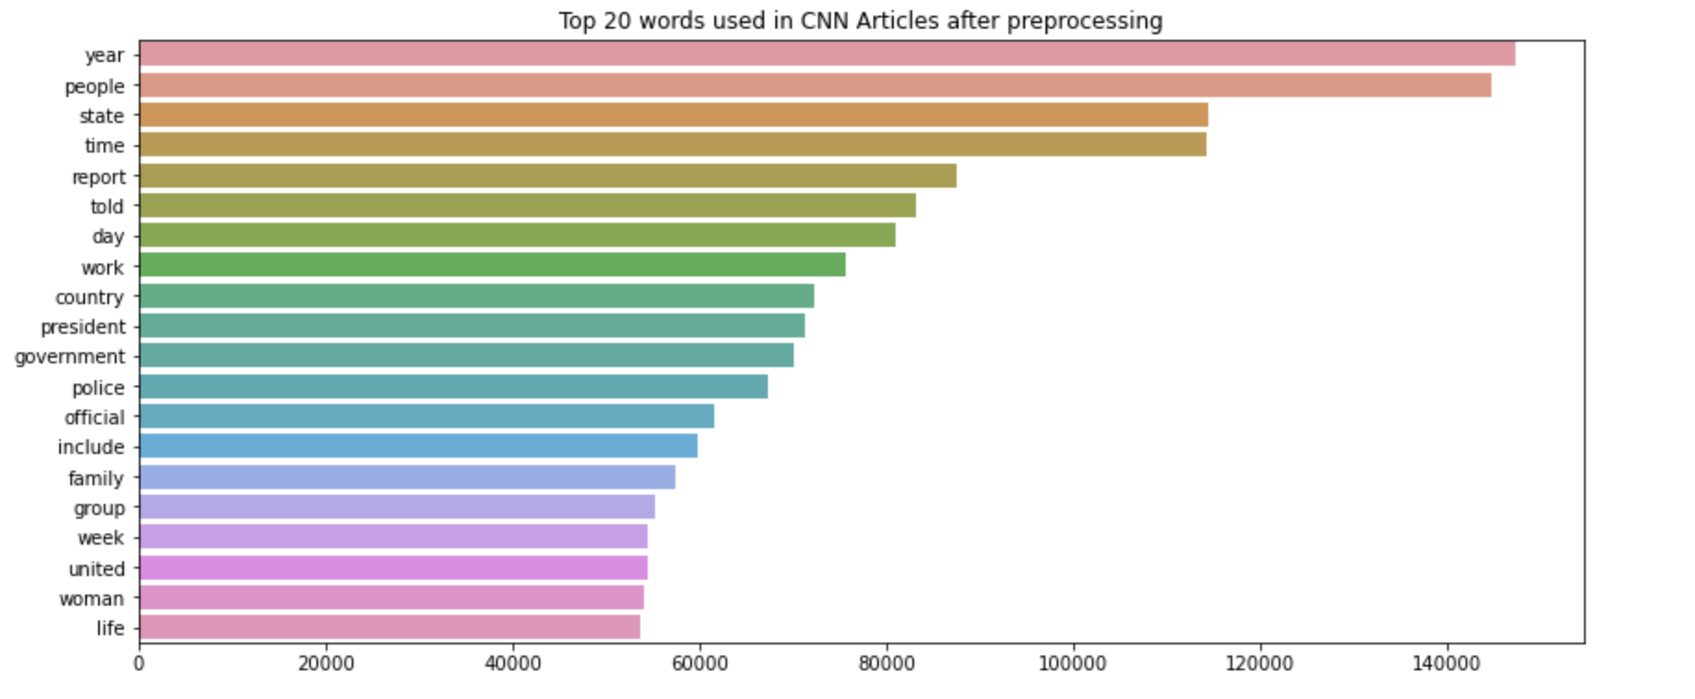
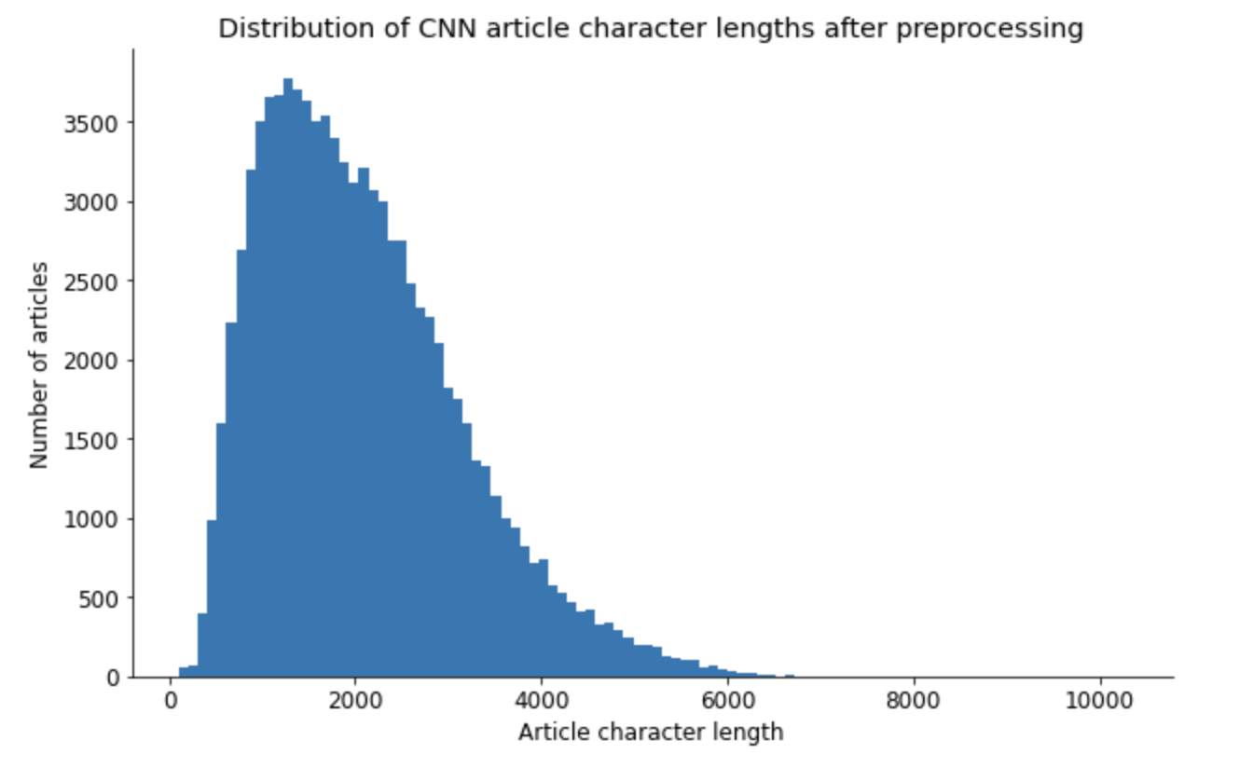
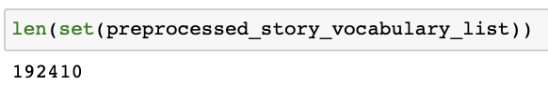
After Preprocessing
Notes:
811223 / 192410 = 4.216 (More than 75% decrease)

Slide 11
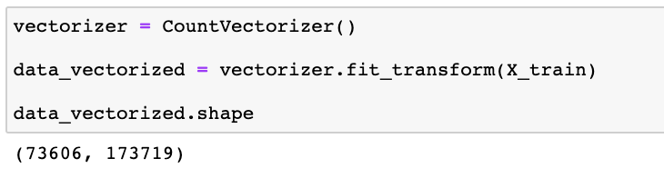
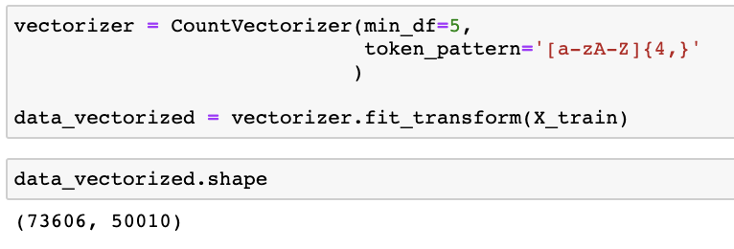
3. Vectorizing- Countvectorizer()
CountVectorizer is essentially a Bag-of-Words model provided by sklearn
Creates sparse data text matrix of token frequencies
Further dimensionality reduction:
Removed all tokens that appear less than 5 times
Removed all tokens less than 4 characters in length (i.e. abbreviations)
10
Notes:
Non-Negative Matrix Factorization (NMF)
Latent Dirichlet Allocation (LDA)
TruncatedSVD

Slide 12
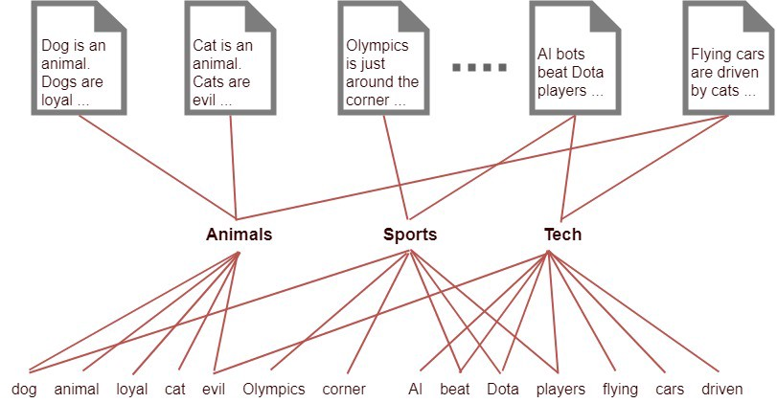
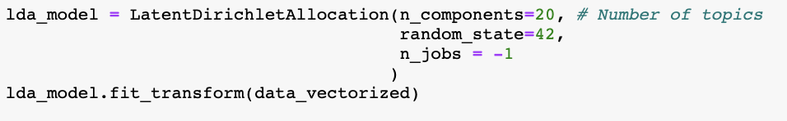
4. modeling- LDA
Latent Dirichlet Allocation gives the probability of these tokens and frequencies belonging to a label or topic
Various packages available, but used sklearn’s version
Set number of output topics and have the model fit to the vectorized text matrix
11
Notes:
Non-Negative Matrix Factorization (NMF)
Latent Dirichlet Allocation (LDA)
TruncatedSVD
LDA is similar to NMF, but utilizes a Dirichlet distribution (Beta distribution)

Slide 13
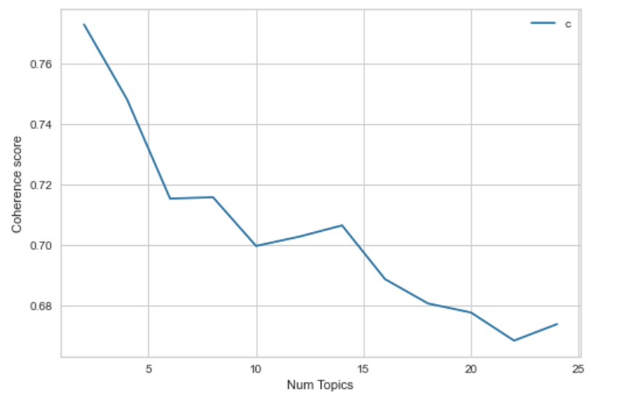
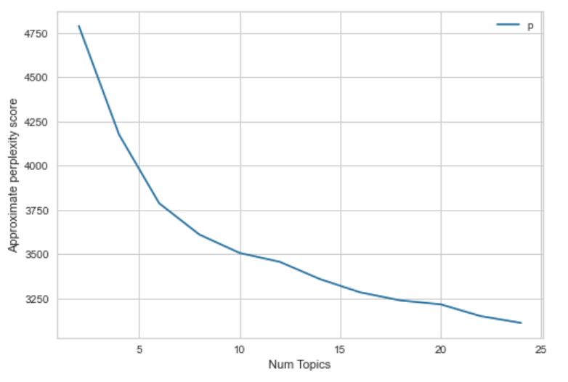
4. modeling- LDA
Notes:
Topic Coherence score measures \the degree of semantic similarity between high scoring words in the topic.
Perplexity is the measure of how well a model predicts a sample. A lower perplexity implies data is more likely. As such, as the number of topics increase, the perplexity of the model should decrease.
Perplexity is a statistical measure of how well a probability model predicts a sample. As applied to LDA, for a given value of , you estimate the LDA model. Then given the theoretical word distributions represented by the topics, compare that to the actual topic mixtures, or distribution of words in your documents.

Slide 14
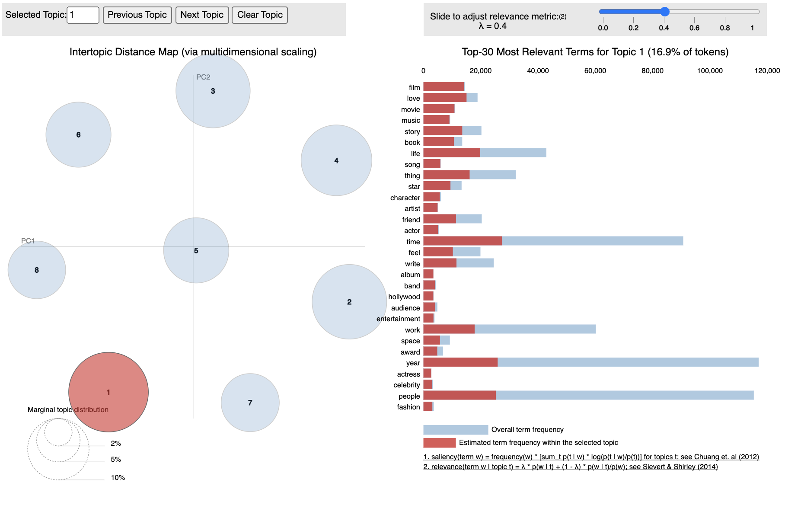
5. Results – Training data

Slide 15
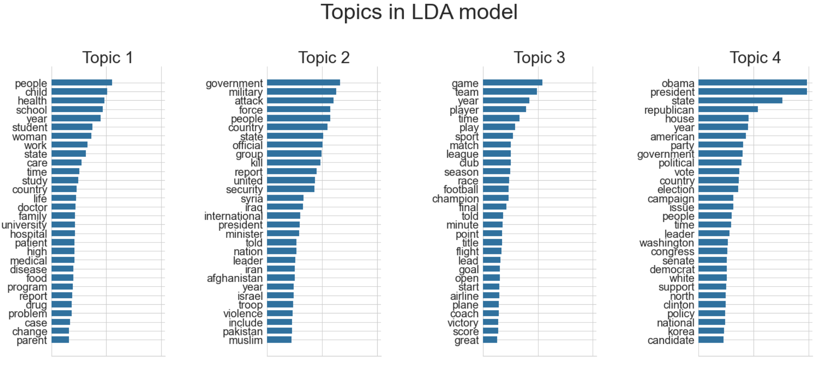
5. Results – Training data

Slide 16
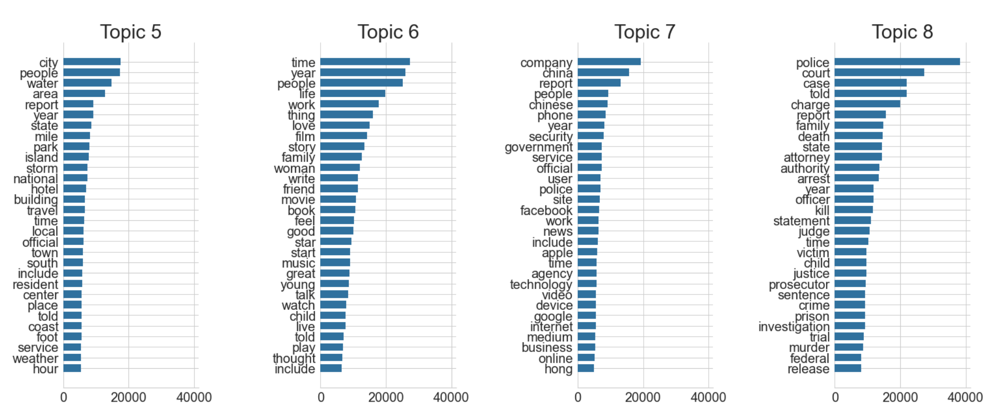
5. Results – Training data

Slide 17
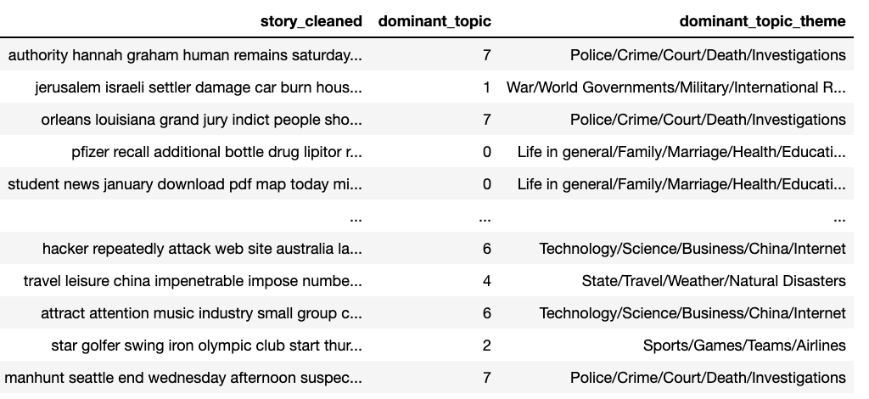
5. Results – Training data

Slide 18
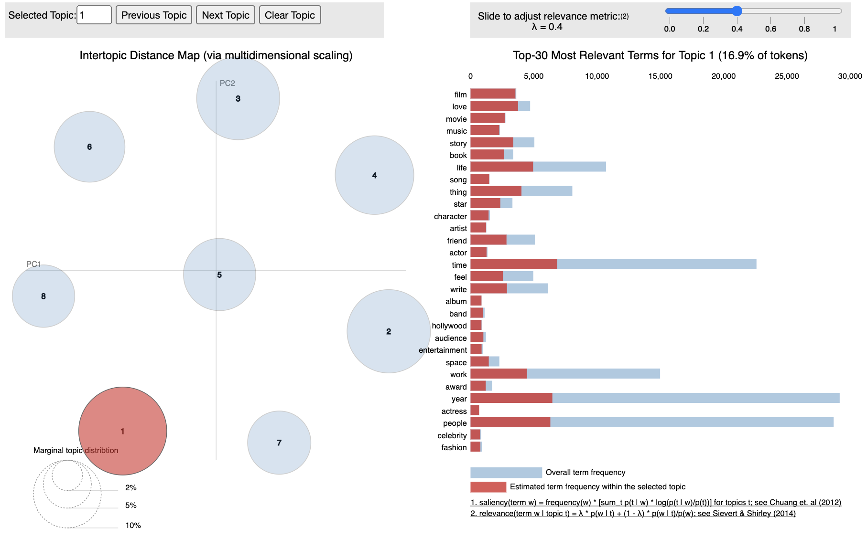
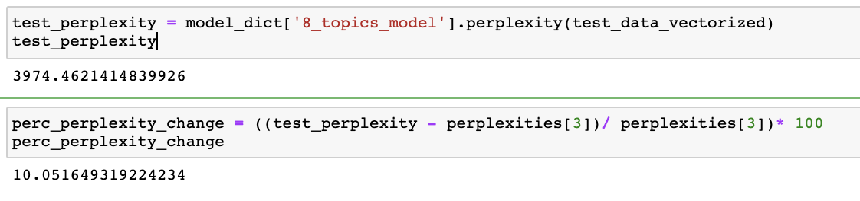
5. Results – Validation data

Slide 19
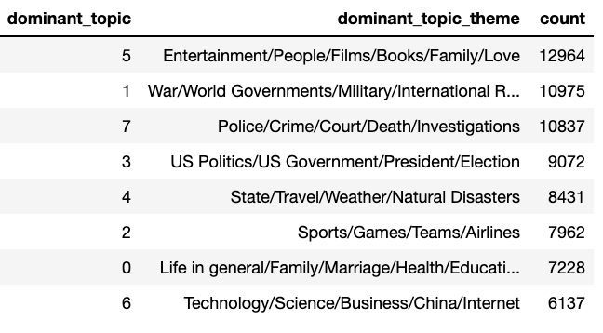
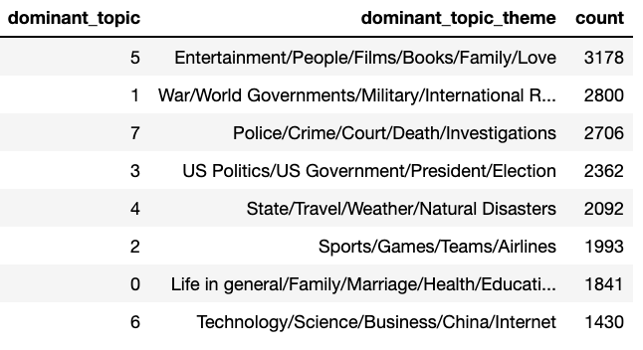
5. Results – TOPIC Comparison
Training Data results
TEST Data Results

Slide 20

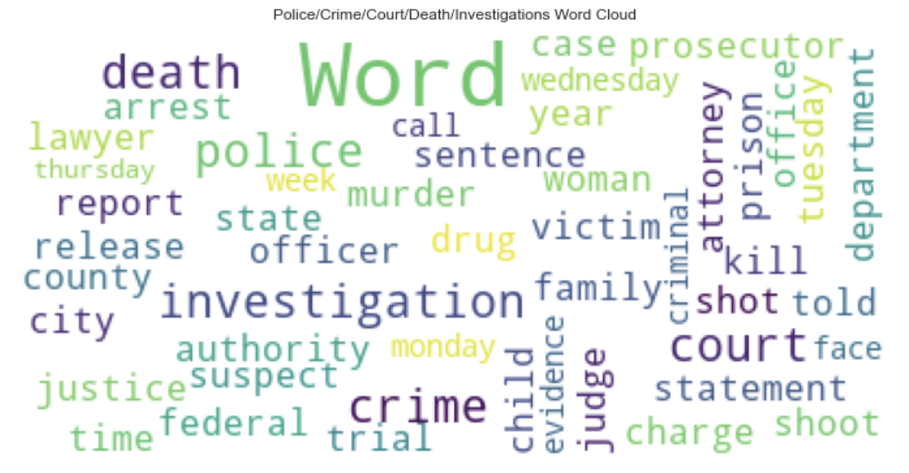
Conclusion
Successfully utilized LDA, an unsupervised NLP generative statistical model to label CNN web articles into topics
Used parameters tuning and metrics analysis to determine the best number of topics
Verified with validation data and only increased perplexity by 10%
19

Slide 21

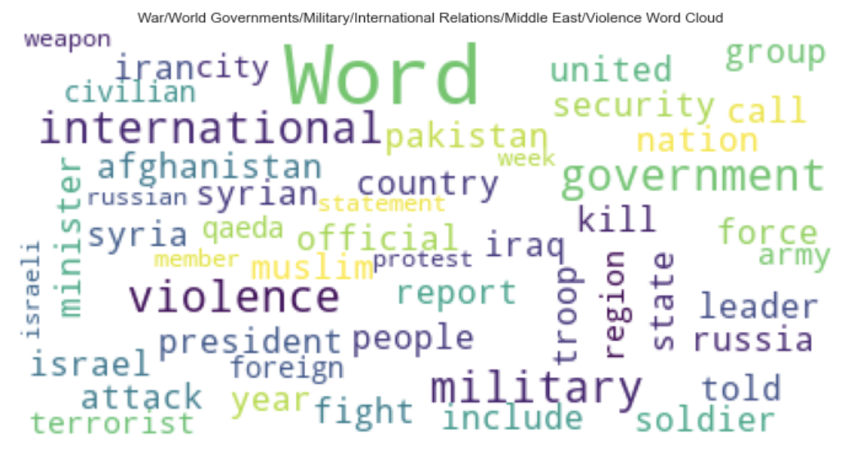
Future Considerations
Extract and clean topic vocabulary data
Analyze publish date data to see topic trends
Streamline pipeline for application use
Input raw text and output topic and key vocab
Build online textbook for ESL current affairs courses
20

Slide 22
Thank you for listening
Barrett Nibling
bnibling@gmail.com

Slide 23
Additional slides

Slide 24
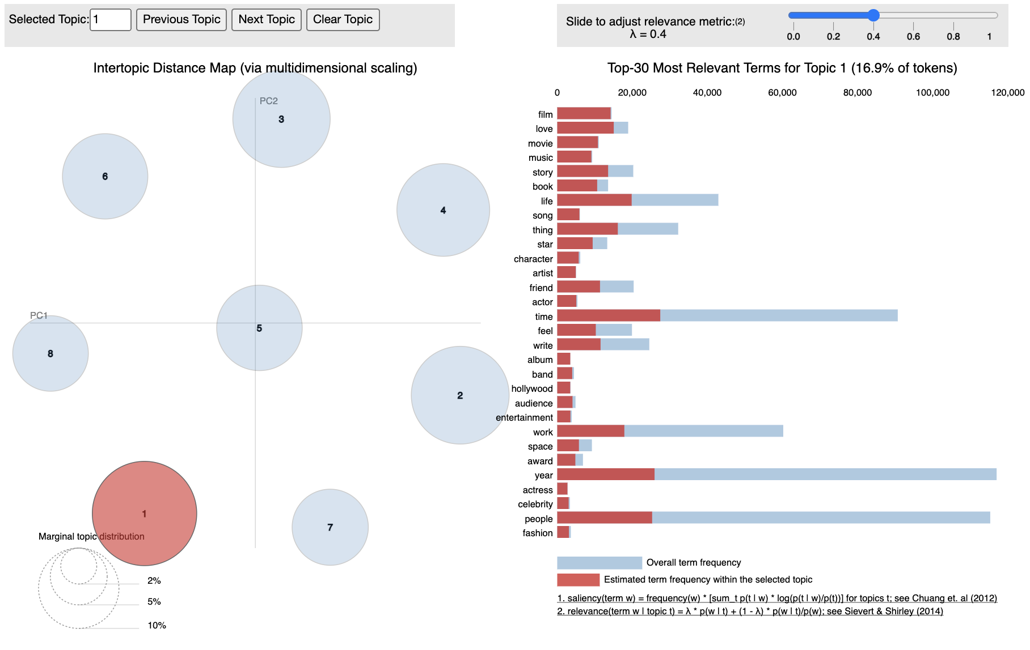

Slide 25
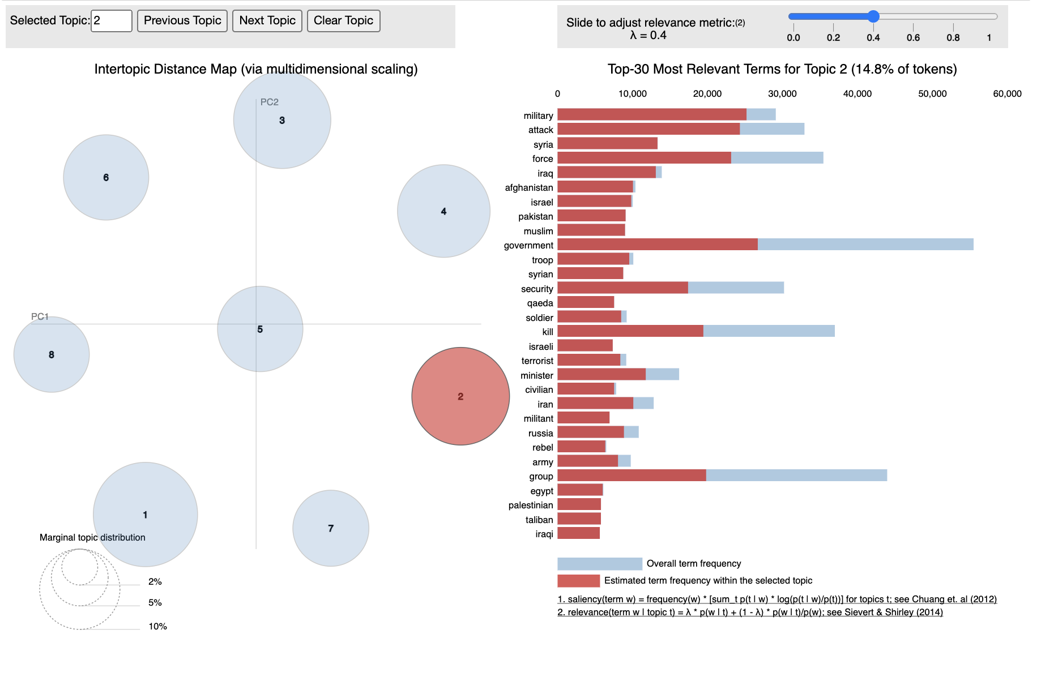

Slide 26
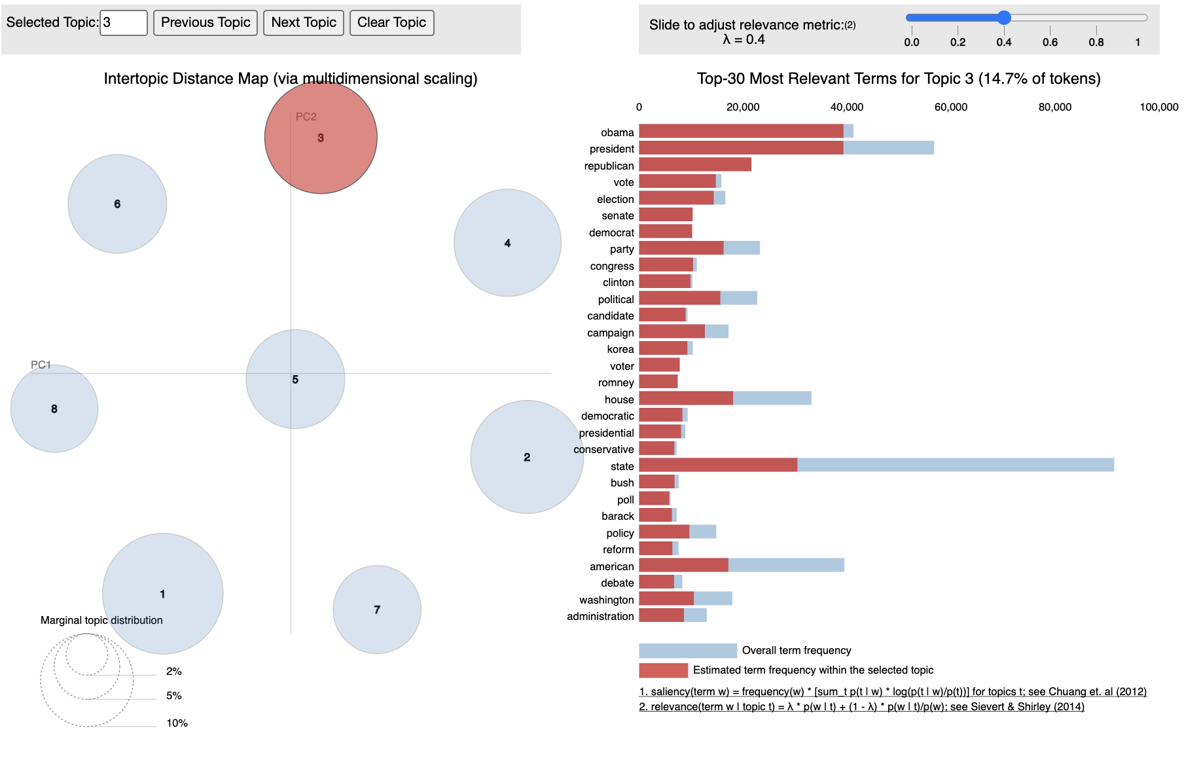

Slide 27
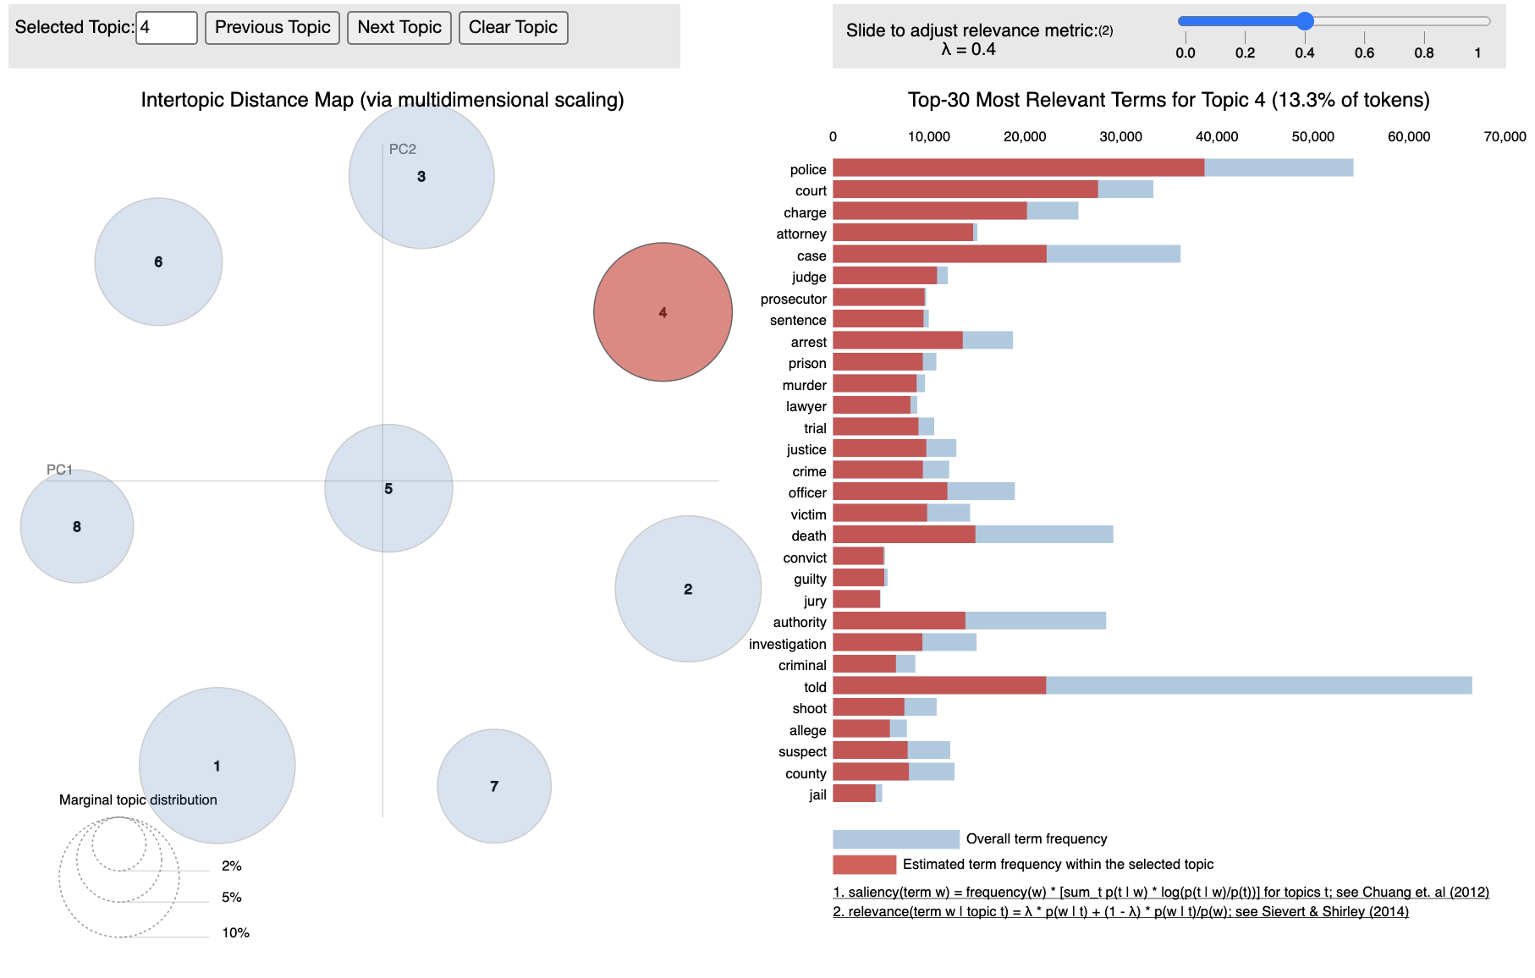

Slide 28
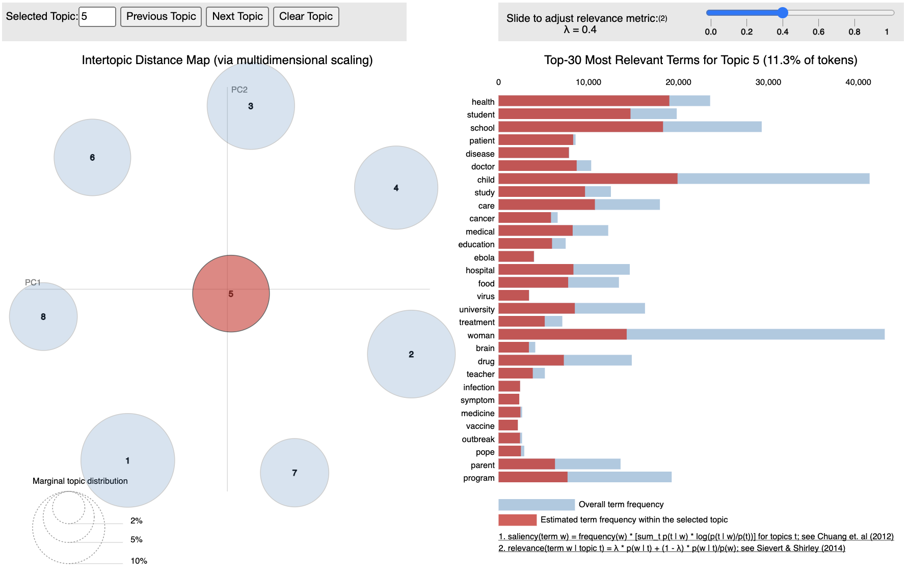

Slide 29
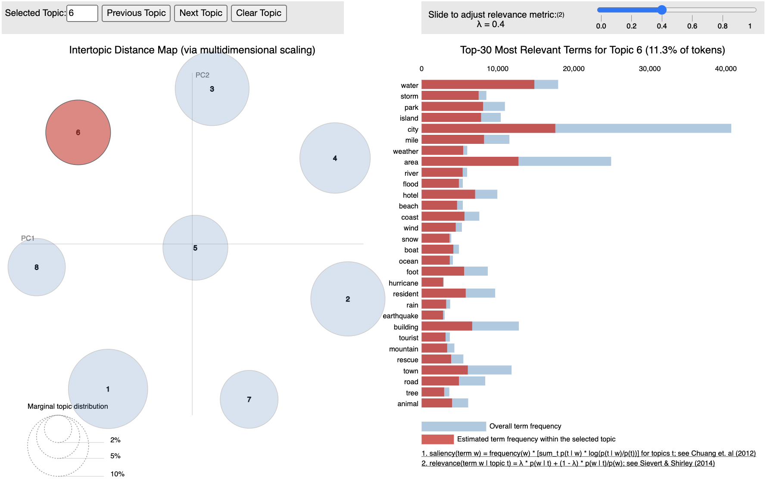

Slide 30
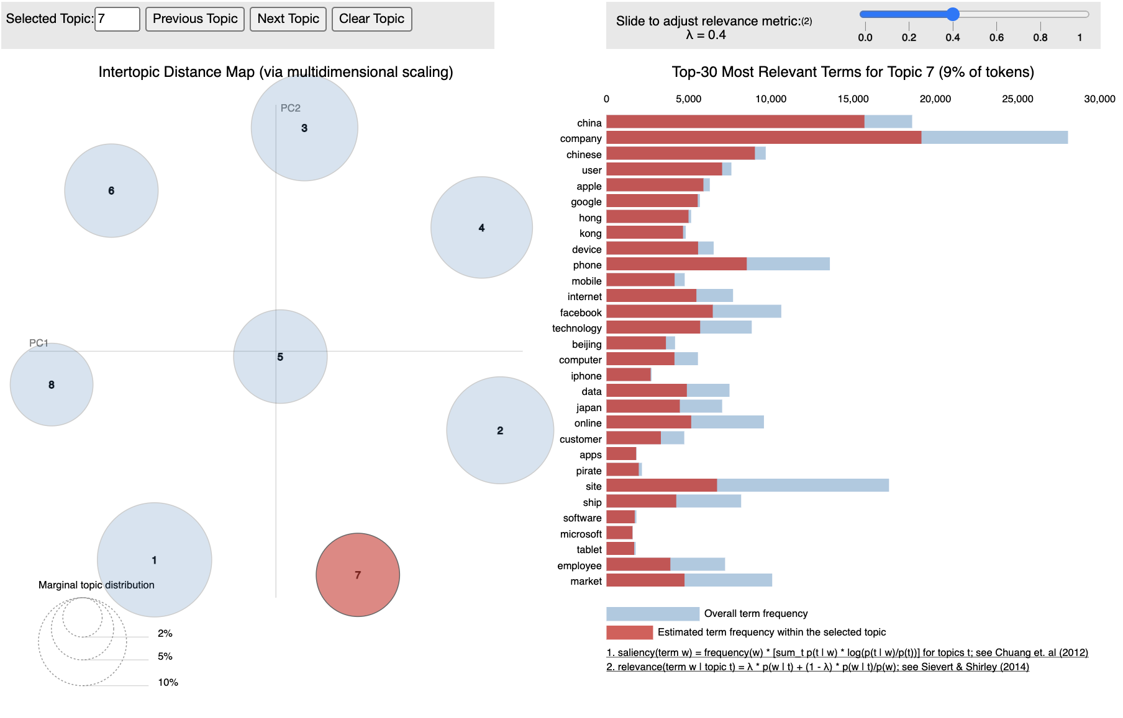

Slide 31
